Slide 1

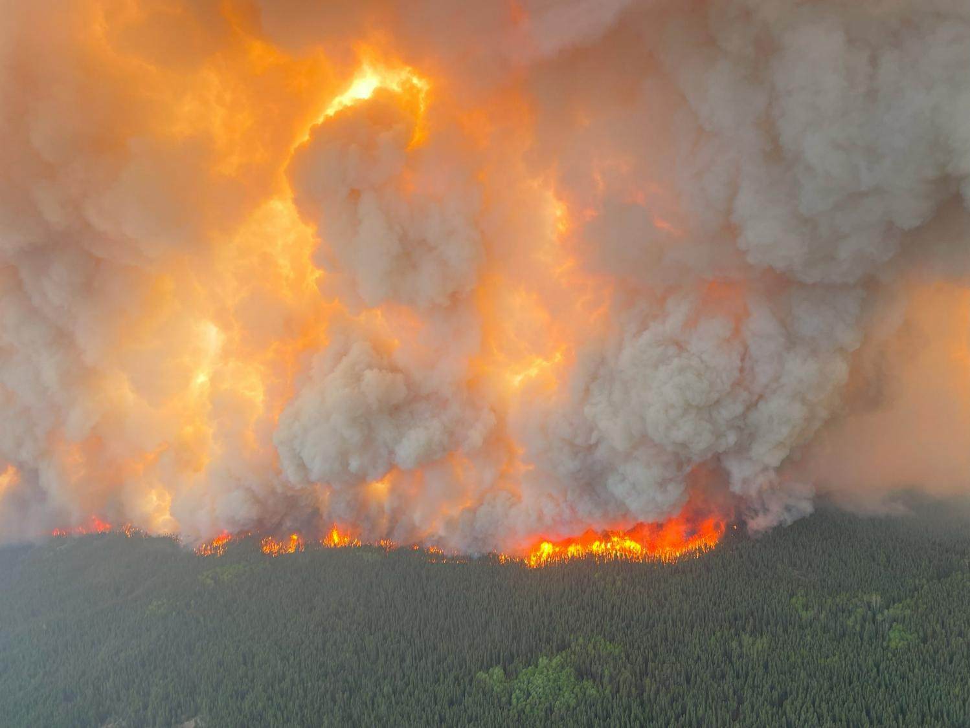
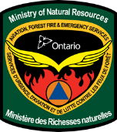
Wildland Fire Mitigation and Preparedness;

Slide 2
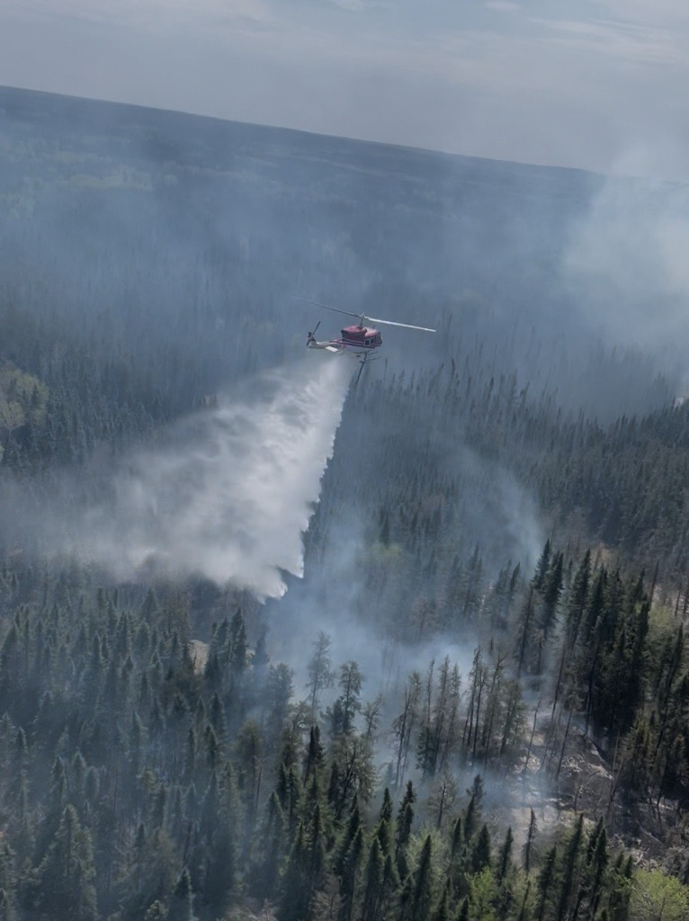
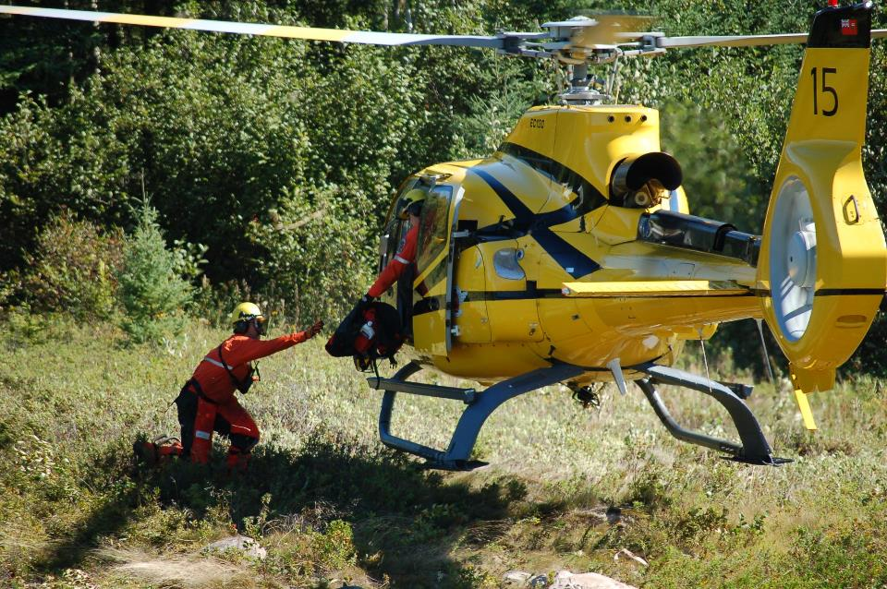
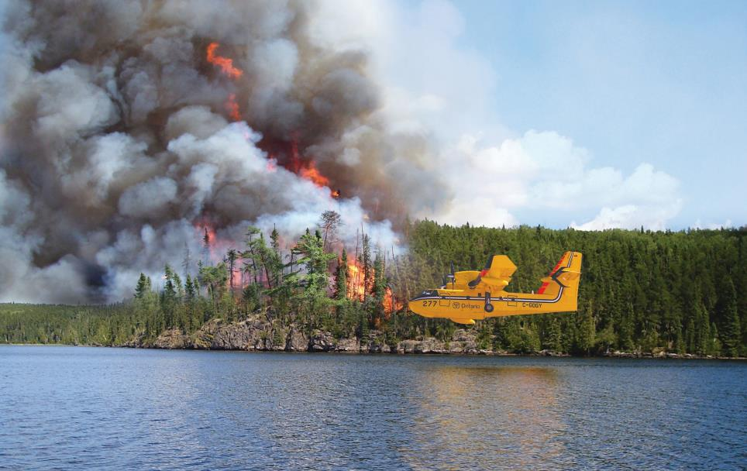
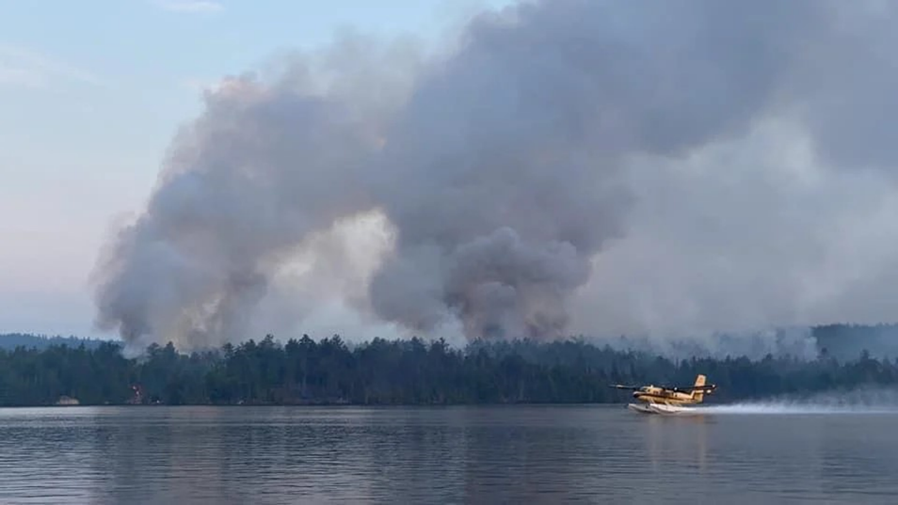
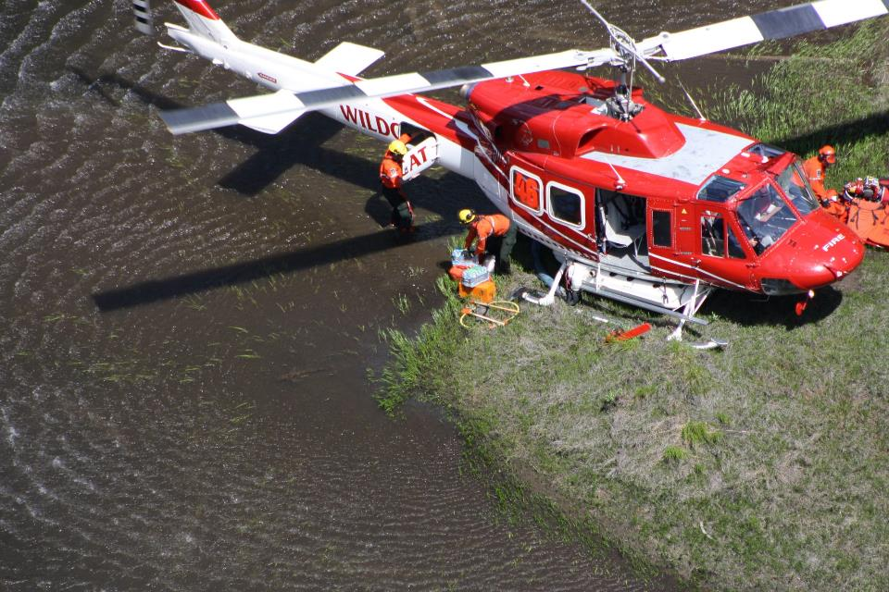
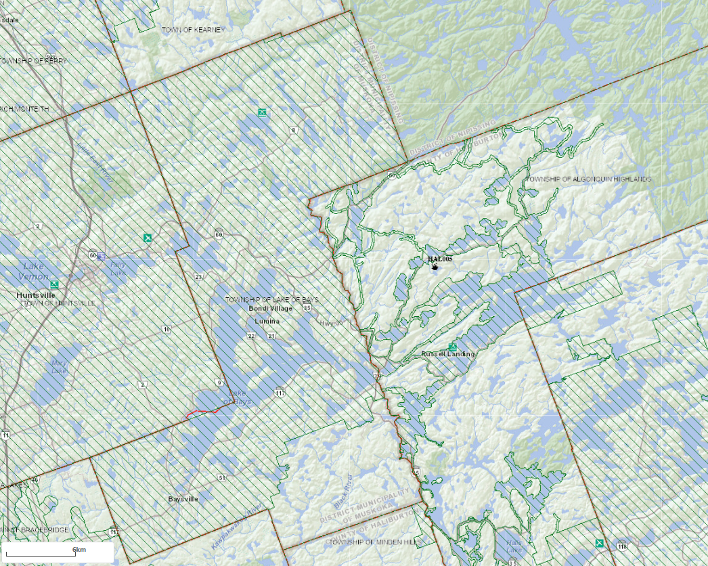
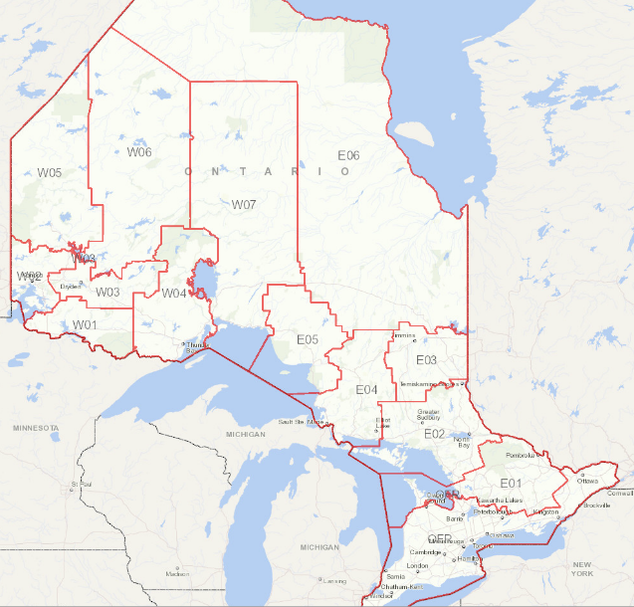
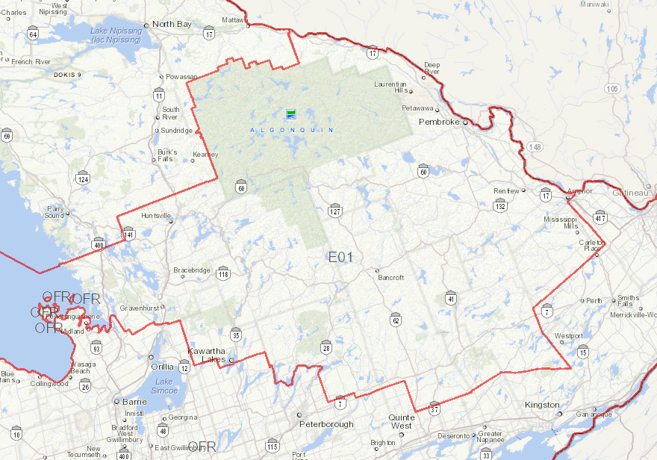
Ontario Wildland Fire Response Sectors
Haliburton Fire Management Headquarters Response Sector E1
Red Lake
Pickle Lake
Sioux Lookout
Geraldton
Kenora
Dryden
Hearst
Haliburton
Cochrane
Fort Frances
Thunder Bay
Wawa
Chapleau
Timmins
Sudbury
North Bay
Legend:
Fire Attack Base
Fire Management Headquarters
Haliburton
Regional Forest Fire Management Center’s
Fire Response Sector Boundary

Slide 3
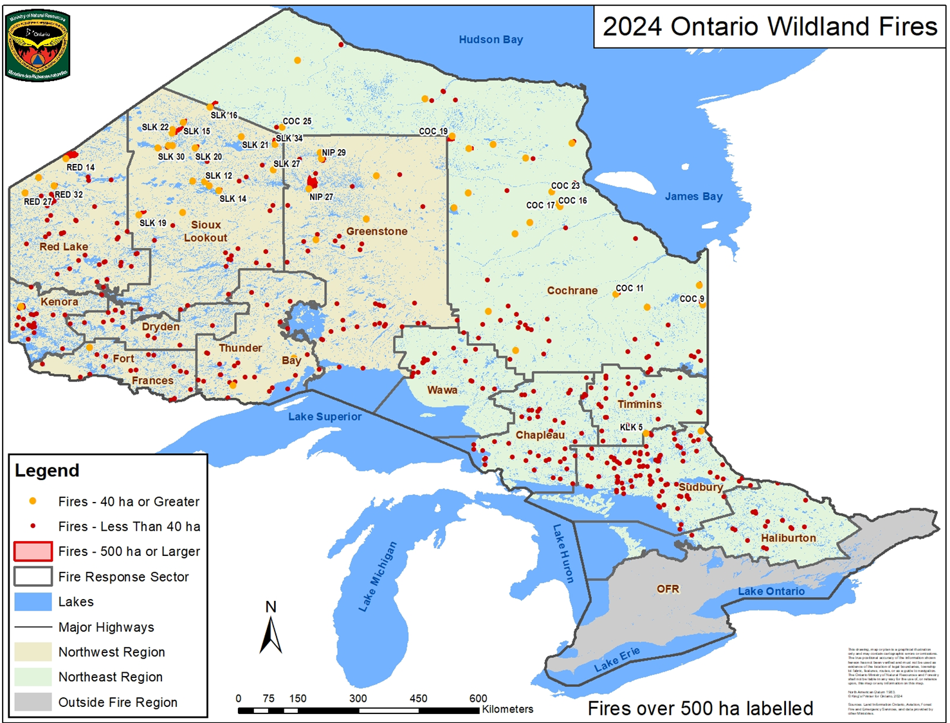
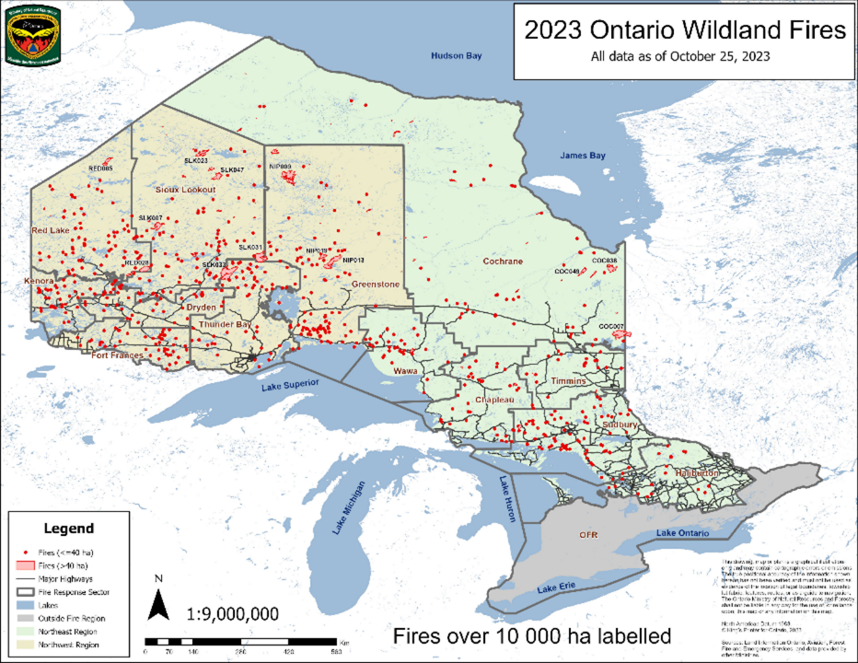
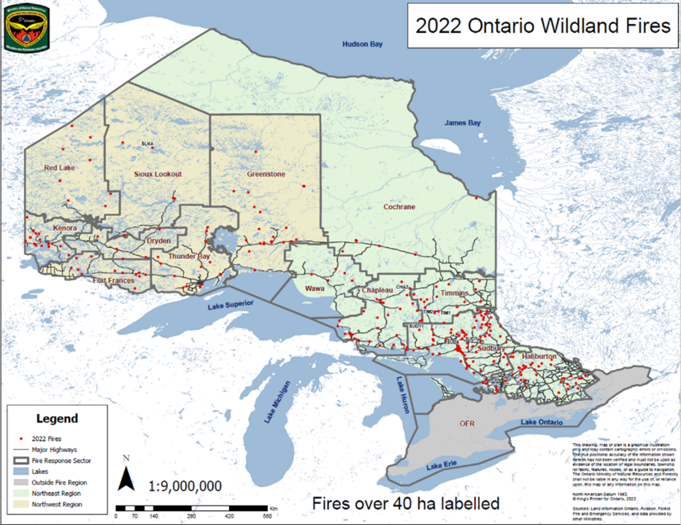
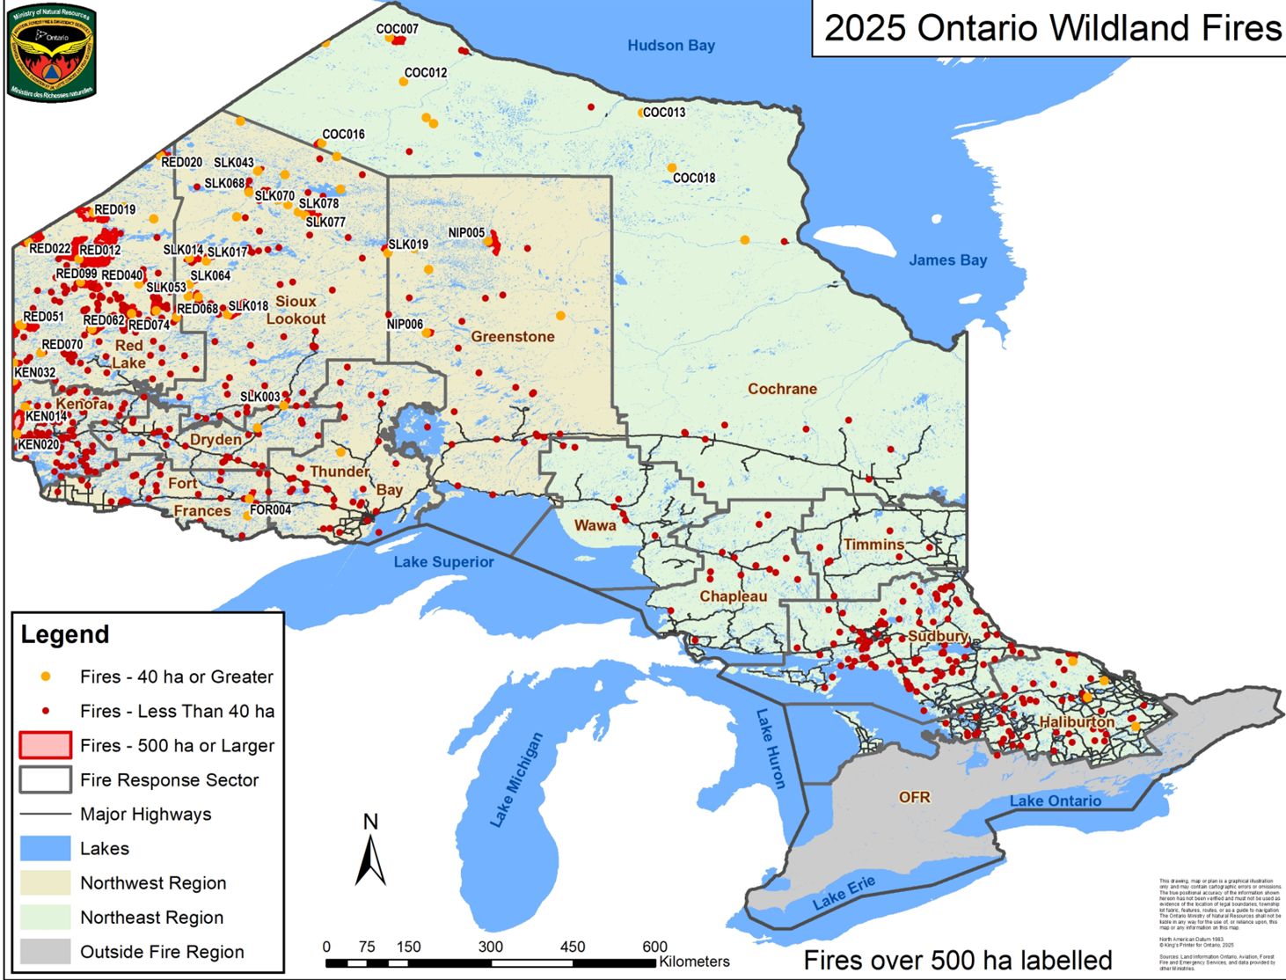
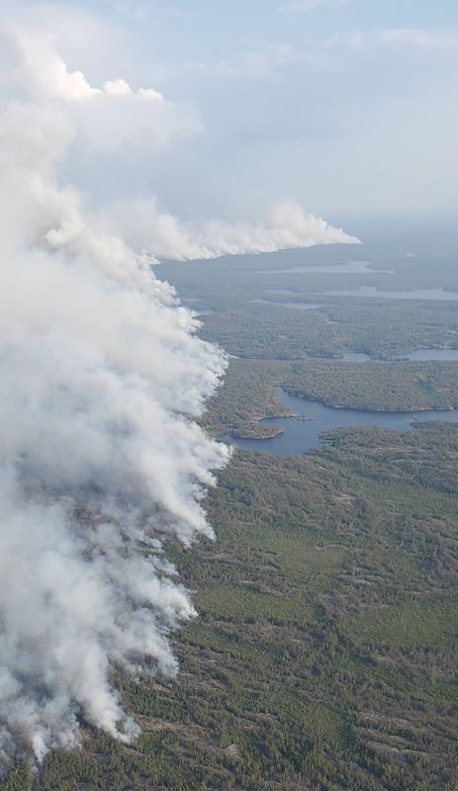
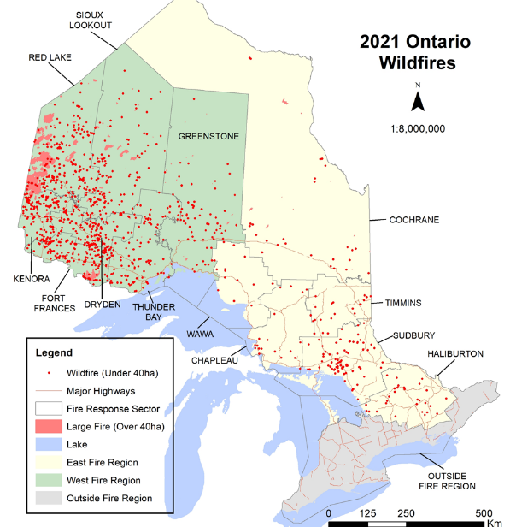
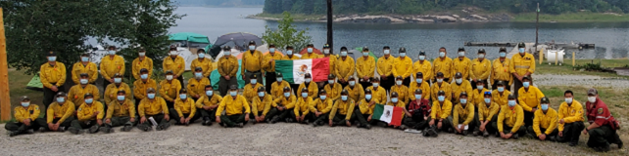
Why should you think about Wildland Fire?
2021 Fire Season saw the most Hectares burnt in a fire season since 1995
1,201 wildfires in Ontario that MNRF actioned
  78% lightning caused / 22% human caused
  1,058 fires with a full suppression objective
  143 fires either monitored, or modified response
793,533 hectares burned
Notes:
2021: 1,201 Fires including PB’s, totaling 793,533 ha
2022: 275 Fires including PB’s totaling only 2,560.3 ha
2023: 743 Fires including PB’s, totaling 441,473.8 ha
2024: 479 Fires, Totaling only 89,841ha.
2025: 643 fires, totaling 597,654.2 ha
2026:

Slide 4
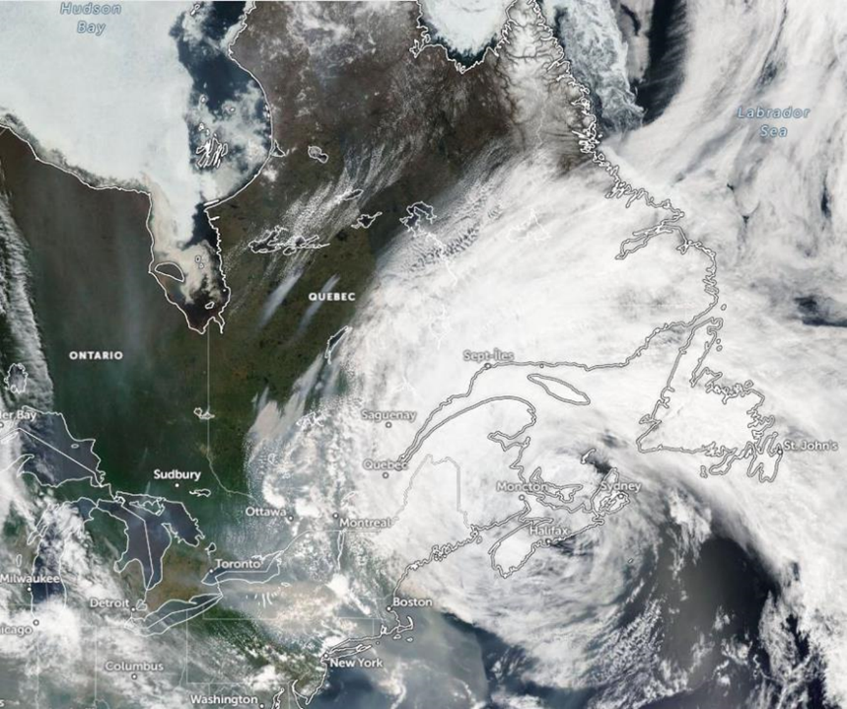
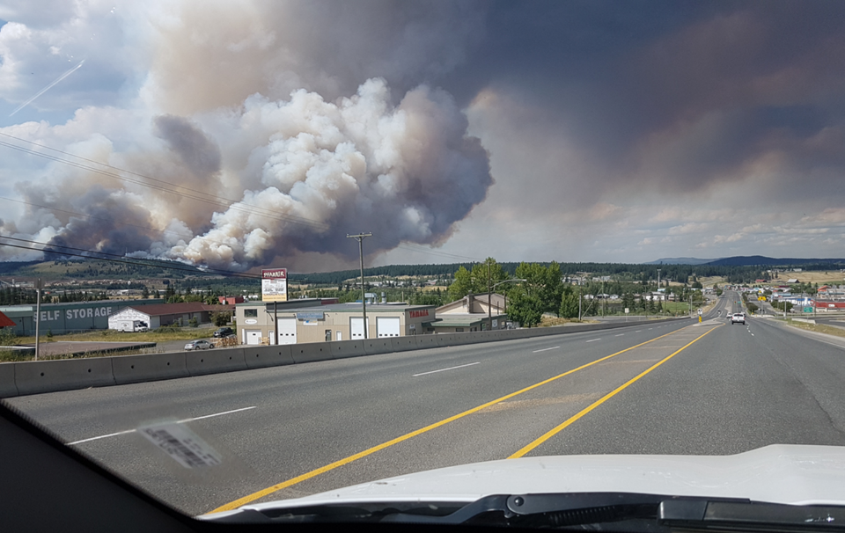
Wildland Fire Negative Impacts

Slide 5
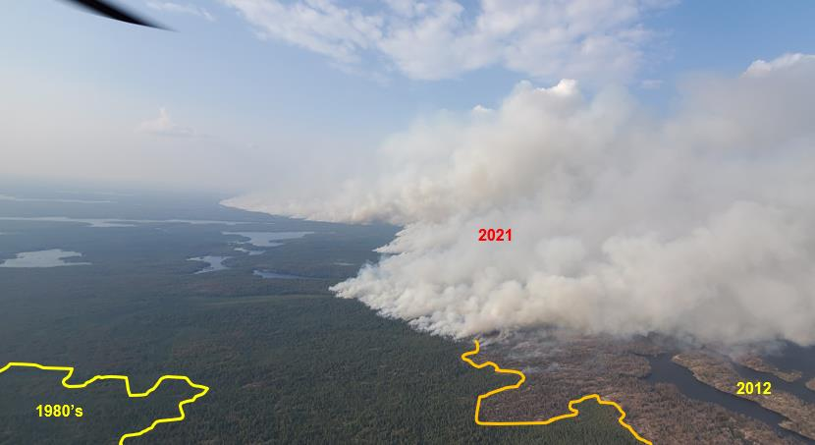
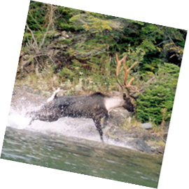
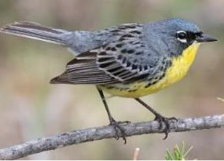
Wildland Fire Positive Impacts

Slide 6
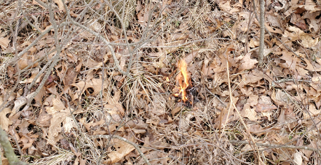
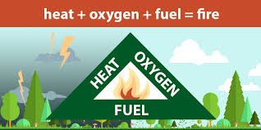
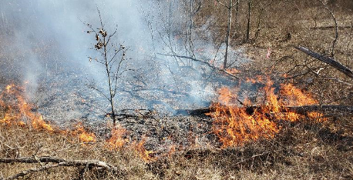
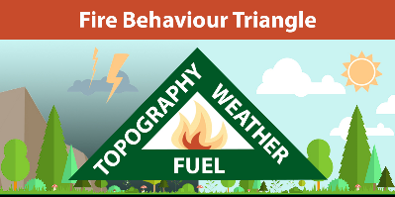
Fire Triangle: elements required for a Wildland Fire flame to develop/sustain:
Fire Environment: elements that affect the Wildland Fire behaviour once it starts:

Slide 7

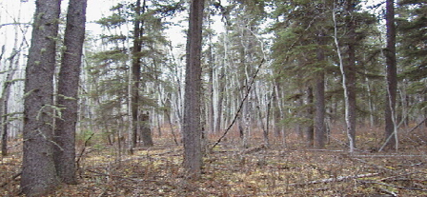
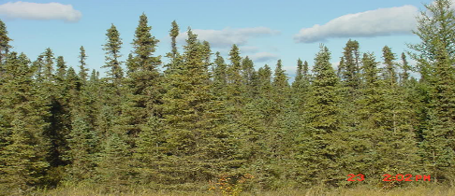
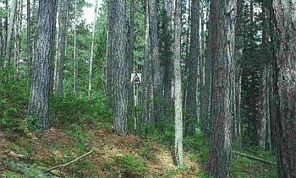
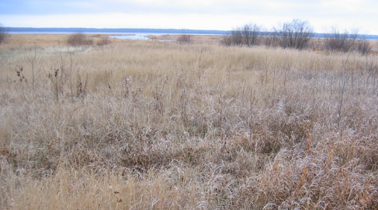
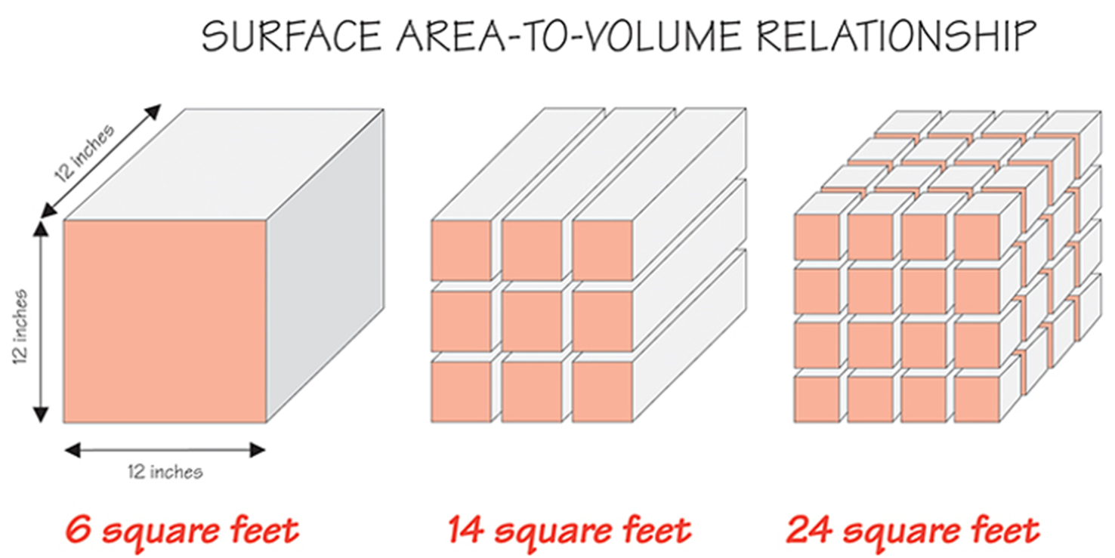
Forest Fuels and Wildland Fire
May 11th, 2023: Actual Weather Observations:
Temp: 23.6 - R/H 34% - Wind: 10km/hr. FFMC 92E – DMC 26M – DC 45L - ISI 10.2H – BUI 26M – FWI 16 High.
Wind Direction
North
Boreal Mix Wood: 4m/min FIC 3,
Boreal Spruce: 9m/min FIC 5
Red and White Pine: 2m/min FIC 2,
Standing Dead Grass: 24m/min FIC 4,

Slide 8
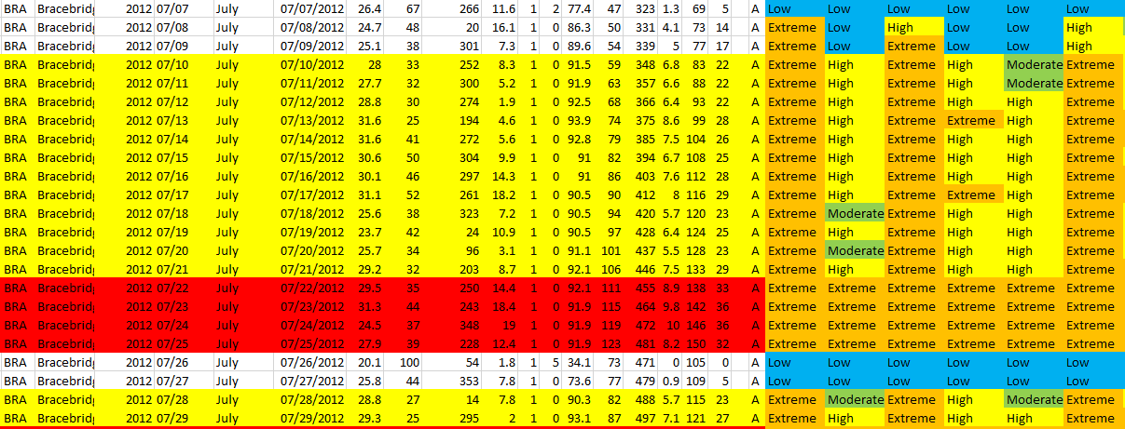
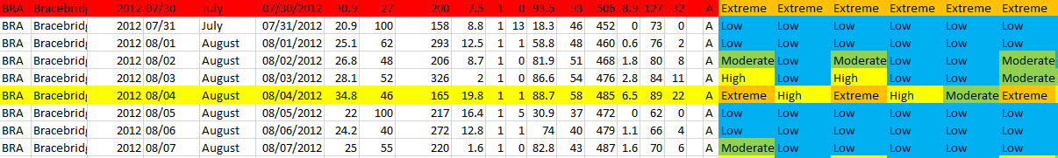
Weather and Wildland Fire
Daytime burning restrictions in relation to daily diurnal effects
Restricted Fire Zones

Slide 9



Slide 10
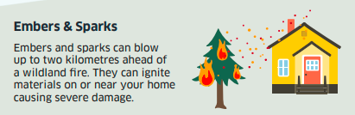
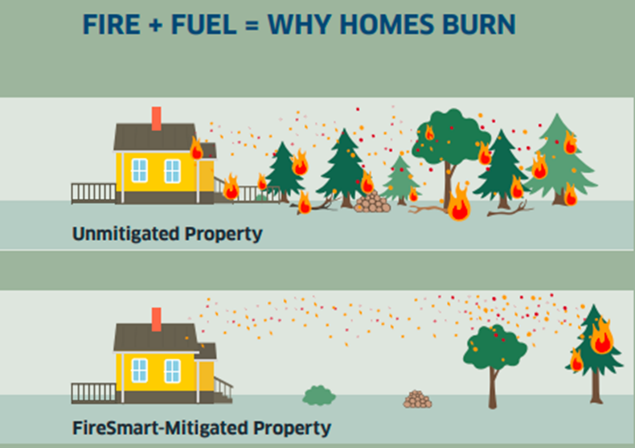
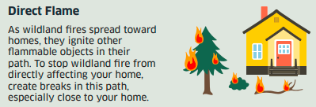
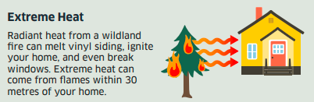

Slide 11
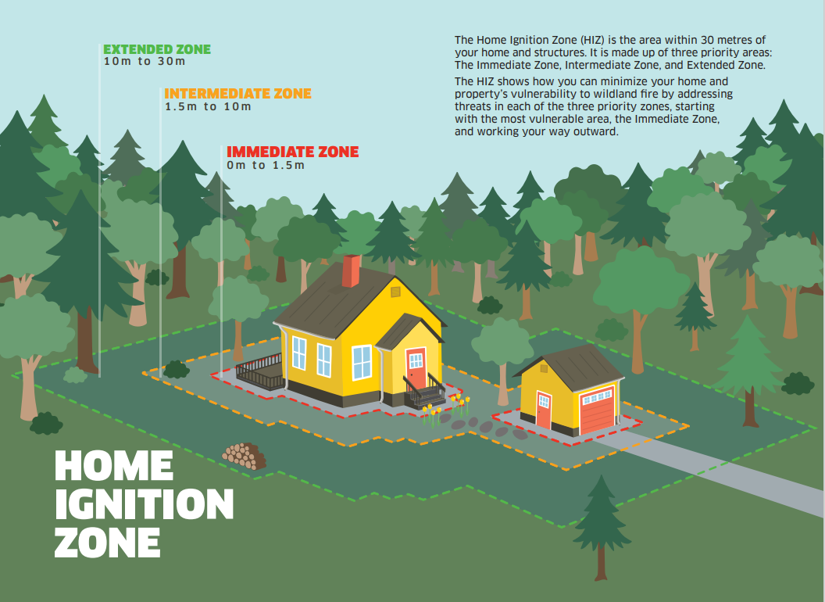

Slide 12
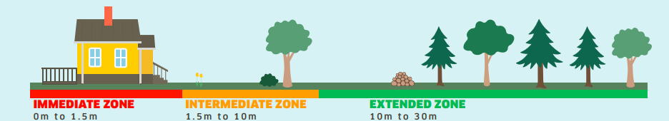
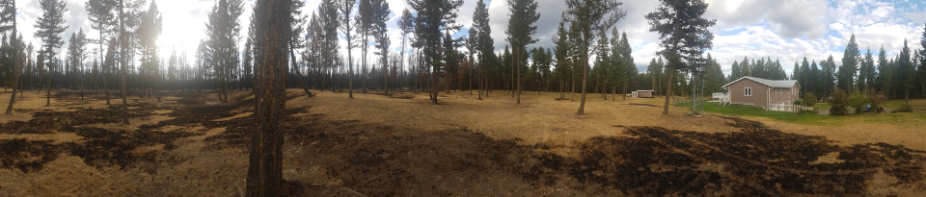

Immediate Zone
Intermediate Zone
Extended Zone

Slide 13
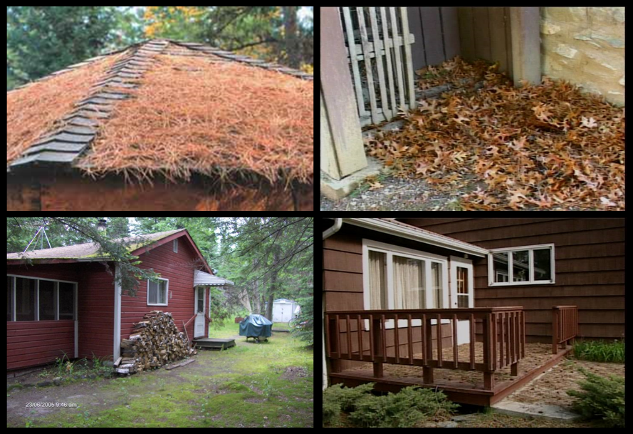
Immediate Zone 0 m to 1.5 m

Slide 14
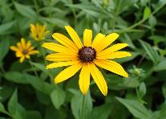
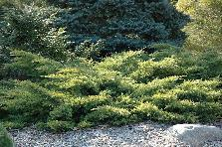
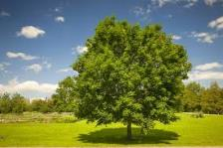
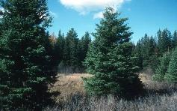
Intermediate Zone 1.5m to 10m
The goal in the Intermediate Zone is to reduce a lot of fire supporting fuel,
Elements in this zone are managed so they do not support fire growth and include naturally occurring fire resistant plants and trees.
Plants:
Because some plants are particularly more flammable than other, it is important in this area to consider deciduous plants rather than conifer plants.
Trees:
Because coniferous trees are particularly more flammable than deciduous trees, it is important in this area to consider deciduous trees rather than conifer.
If conifers are still preferred for other factors; then prune and space to lessen fire intensity.
Plants less flammable:
Fire resistant plants are those that do not readily ignite from flame or embers. They do not contribute to wildland fire intensity and include characteristics such as:
Moist, supple leaves
Limited dead woody stems
Water-like sap with little or no odor
Low amount of sap
Plants more flammable:
Some plants are more flammable and should be considered avoiding when re-planting within 10 meters of a structure. Characteristics include:
Fine, dry papery material within the plant. (Bark)
Volatile waxes, terpenes or oils, sticky sap with odor.
Leaves are aromatic.
Trees less flammable:
Deciduous trees (Leafy) are more resistant to wildland fire and include:
Poplar
Birch
Aspen
Maple
Ash
Cherry
Oak
Basswood
Trees more flammable:
Coniferous trees (needles) are more flammable and should be considered avoiding when re-planting within 10 meters of a structure
Spruce species
Fir Species
Pine Species
Cedar Species

Slide 15
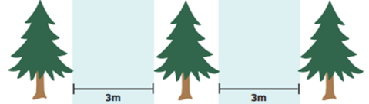
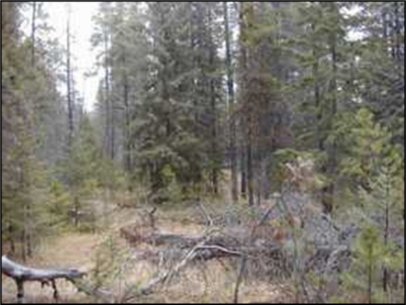
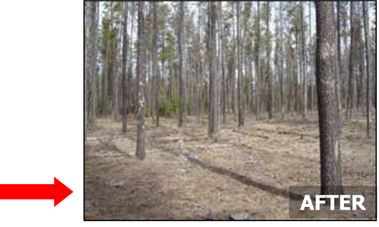


Extended Zone 10m to 30m
The goal in the Extended Zone is not to eliminate fire by removing all fuel,
However, rather to reduce Fire Intensity by removing some flammable fuels.
2m
2m
2m
Coniferous Tree Pruning
Because coniferous trees are particularly more flammable than deciduous trees, it is important to prune conifers lower limbs. As a general direction of guidance 2 meters between crown base height and the ground is enough to reduce Surface to crown fire growth.
Coniferous Tree Spacing
Because coniferous trees are particularly more flammable than deciduous trees, it is important to thin conifers 3m apart between the outermost branches, as a rule of thumb. 3 meters between crowns is enough to reduce crown to crown fire growth.

Slide 16

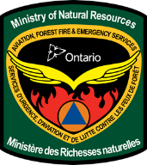
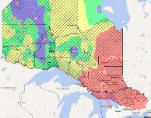

Firesmartcanada.ca
Ontario Interactive Fire
Map:
Federal Fire Hazard
Map:

